Slide 1
Privacy, Confidentiality, and Statistical Purposes
Administrative Data Research Conference
June 25, 2025
Michael Hawes
Senior Statistician for Scientific Communication
U.S. Census Bureau
Any viewpoints or opinion’s expressed are the presenter’s own and do not represent the viewpoints or opinions of the U.S. Census Bureau

Slide 2

Benefits of Administrative Records for Official Statistics
Reduce respondent burden
Reduce costs
Improve data quality
Create blended data products
Notes:
“To the maximum extent possible and consistent with the kind, timeliness, quality and scope of the statistics required, the [Census Bureau] shall acquire and use information available from [administrative records] instead of conducting direct inquiries.” 13 U.S.C. (6)(c)

Slide 3
Mechanisms to Share
There are numerous statutory provisions and frameworks for statistical agencies to acquire administrative records, including:
Privacy Act -- 5 U.S.C §552(b)(4)
Evidence Act – 44 U.S.C. §3581
Internal Revenue Code – 26 U.S.C. §6103(j)
...to name just a few.

Slide 4
In fact, statistical agencies are often required to use administrative records over direct survey collections whenever practicable.
“To the maximum extent possible and consistent with the kind, timeliness, quality and scope of the statistics required, the [Census Bureau] shall acquire and use information available from [administrative records] instead of conducting direct inquiries.” 13 U.S.C. §(6)(c)
Notes:
“To the maximum extent possible and consistent with the kind, timeliness, quality and scope of the statistics required, the [Census Bureau] shall acquire and use information available from [administrative records] instead of conducting direct inquiries.” 13 U.S.C. (6)(c)

Slide 5
“Statistical Purposes” Only
Once acquired by a federal statistical agency, these records are typically afforded strong confidentiality and data access and use protections.
These limit the use of the data "for statistical purposes only"
To ensure that information supplied by individuals or organizations to an agency for statistical purposes under a pledge of confidentiality is used exclusively for statistical purposes.
To ensure that individuals or organizations who supply information under a pledge of confidentiality to agencies for statistical purposes will neither have that information disclosed in identifiable form to anyone not authorized by this subchapter nor have that information used for any purpose other than a statistical purpose.
To safeguard the confidentiality of individually identifiable information acquired under a pledge of confidentiality for statistical purposes by controlling access to, and uses made of, such information.
Confidential Information Protection and Statistical Efficiency Act [44 U.S.C. §3572(a)]

Slide 6
Privacy and Confidentiality Challenges with Increased Administrative Record Usage

Slide 7

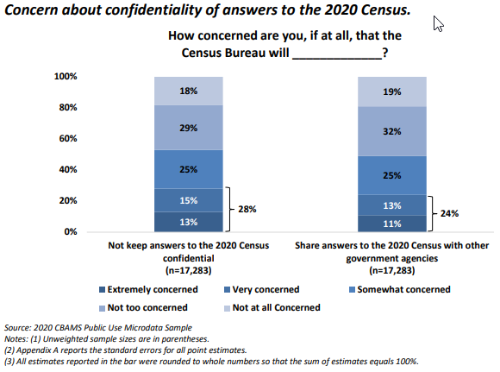
Privacy attitudes are a barrier to survey participation
53% of respondents were “somewhat,” “very,” or “extremely” concerned about the Census Bureau’s ability to protect the confidentiality of their data.
49% thought the Census Bureau would share their information with other government agencies.
2020 Census Barriers, Attitudes, and Motivators Study Survey Report
Notes:
Well, Survey participation, and consent for record linkage largely rely on voluntary participation, and research shows that privacy concerns directly affect that willingness. The 2020 Census Barriers, Attitudes, and Motivators Study survey (or CBAMS for short) found that 53% of respondents were “somewhat,” “very,” or “extremely” concerned about the Census Bureau’s ability to protect the confidentiality of their data. And 49% thought the Census Bureau would share their information with other government agencies.

Slide 8

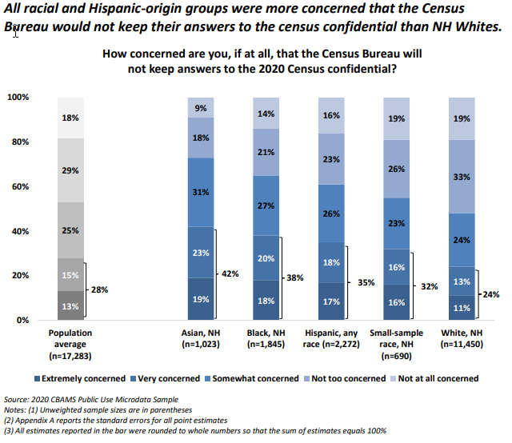
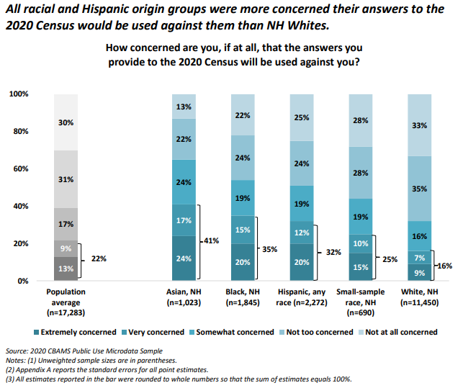
Privacy attitudes vary by demographic group
2020 Census Barriers, Attitudes, and Motivators Study Survey Report
Notes:
And those concerns about confidentiality and potential privacy harms are not evenly distributed across society…there are major differences in attitudes across demographic groups. The CBAMS study, for example, found that all racial and Hispanic-origin groups expressed greater concern about the confidentiality of their data and the potential for their information to be used against them than did non-Hispanic whites.

Slide 9

Privacy attitudes are contextual
Individuals supply data within a particular social, institutional, or administrative context
Expectations and concerns about privacy will vary widely across contexts (even for the same data element)
Notes:
Privacy is also inherently contextual. People readily share information with their doctor that they would never discuss with a coworker…. And teenagers, often, perhaps erroneously labeled as unconcerned about privacy, may freely choose to share information with their peers on social media platforms that they would never tell their parents.
When individuals volunteer their personal information, they do so within a specific social, institutional, or administrative context, and their expectations and concerns about privacy are directly shaped by those contexts. Transfer that same information to a different context and the same individual’s privacy attitudes may be totally different. Helen Nissenbaum and other scholars of contextual privacy have studied this in depth.

Slide 10

Privacy attitudes are transactional
Fears about privacy “…do not translate into a universal yearning for anonymity. In fact, almost two-thirds of [survey respondents] are comfortable with disclosing information under the terms of the basic Information Age bargain: ‘I give you a piece of information about me in return for something of value from you.’”
-Lee Rainie, Pew Internet & American Life Project
Notes:
Much of the time, Privacy is also fundamentally transactional. People who strongly value their privacy often still voluntarily share their personal information even for minimal benefits in return…grocery store frequent shopper cards, “free” online apps and services, and “sign up for a discount code” deals are all just a few examples of this bartering of information for something tangible. The value gained in return for the information sharing may not be substantial…50 cents off a cheeseburger…but it is still tangible. And that tangibility of return can greatly impact individuals’ privacy calculus.

Slide 11

Privacy attitudes are difficult to anticipate
“…privacy [is] a ‘landmine issue’ because it is something which may blow up in the faces of people who are not expecting it. They are not aware that it is there as an issue until it blows up.
When we ask people to tell us what issues are important to them spontaneously, they very rarely mention privacy. It is not usually a top-of-the-mind issue. But whenever we ask people about the importance of privacy, they almost invariably tell us that it is important or very important.”
-Humphrey Taylor, The Harris Poll
Notes:
In any privacy calculus, one would presumably weigh the benefits of providing personal information against the potential privacy harms. But privacy harms are often very abstract with unknown time horizons. As a result, privacy can be, in the words of Humphrey Taylor, a “landmine issue” people are often unaware that privacy is a serious issue until it blows up. – next slide

Slide 12

Privacy attitudes change over time
Take everything I’ve just said with a big grain of salt!
“…public opinion on privacy issues is not stable, it changes, and will continue to change”
-Humphrey Taylor, The Harris Poll
Notes:
Which brings me to this point: Privacy attitudes change over time. So don’t assume that just because something isn’t perceived as a privacy concern today that it won’t become a major issue tomorrow.
Now, this also means that you should take everything I’ve said so far in this presentation with a grain of salt. As public opinion and attitudes about privacy evolve, and especially as privacy takes a more prominent role in public discourse, our research and understanding of how individuals’ attitudes about privacy are shaped may be outdated.

Slide 13

Messaging about data protections may hurt rather than help
“…respondents will extract information about the nature of a survey from the confidentiality assurances given to them. If these assurances are very elaborate, respondents are likely to infer that the survey is sensitive and that they will be asked a number of questions that may be unpleasant, embarrassing, or incriminating.” -Singer, Hippler, and Schwarz (1992)
Landreth, Gerber, and DeMaio (2008) also note:
Messaging about “confidentiality,” “statistical purposes,” and linkage to administrative records is often misunderstood, or seen as vague or open-ended
Messaging about legal protections and penalties for unauthorized disclosure was variously interpreted as “legalese,” the “fine print,” or “over the top”
Notes:
Lastly, I want to point out one very interesting finding about public attitudes towards survey participation and data sharing: Messaging about confidentiality and data protections may actually hurt, rather than help, participation rates. Singer Hippler and Schwarz, for example, found that providing strong messaging about confidentiality prior to a survey could lead data subjects to infer that the survey was more sensitive or potentially “unpleasant, embarrassing, or incriminating” than it actually was, lowering participation.
Similarly, Landreth, Gerber, and DeMaio found that much of our commonly used communications about confidentiality and privacy protections are actually (at best) misunderstood or (at worst) perceived as equivicating or hyperbolic.

Slide 14
What does this mean in the context of blended data?
Notes:
So, what does this all mean about privacy communication in the context of blended data?

Slide 15

Privacy risks can be greater for blended data
Blended data can produce a richer, more complete picture of the data subject than the original source files
Linkable files “out in the wild” may increase re-identification risk
Notes:
Well, as we’ve heard in presentations throughout this workshop, the privacy risks for blended data are often greater than the comparable risks for the data sources on their own. Blended data are a richer, more complete picture of the data subject than the original source files, and Linkable files “out in the wild” increase re-identification risk from attackers with access to those files.

Slide 16

Privacy is contextual, but the context of privacy in re-purposed (blended) data is very different than the context in which the data were originally collected
Notes:
Also, reuse and repurposing of data collected for one purpose calls into question the data subject’s privacy expectations. If privacy is contextual and transactional, then data sharing and re-use of these data for statistical purposes changes the context and alters the transaction (adding a potential cost, without a clear added benefit), and may change the data subjects’ expectations about proper or improper use of their personal information.

Slide 17

Informed consent notices or statements may not foresee the types of future uses
Notes:
Similarly, the typical model of informed consent for data sharing and record linkage, it problematic from a privacy standpoint insofar as it is often difficult to anticipate what the future statistical uses of the data may be…leading to vague or open-ended consent statements that do little to inform data subjects about the actual risks and benefits involved.

Slide 18

Privacy protections are harder to quantify
Sequential data releases by each data curator are not (typically) coordinated
Hence, disclosure controls employed by the data curators may not be composable, undermining efforts to effectively assess and mitigate disclosure risk.
Notes:
Furthermore, on the subject of the potential privacy risks and harms, quantifying privacy risk and harm is more challenging for blended data than for traditional statistical data collections. When the same data are held by multiple curators and used for different purposes, Sequential data releases by each data curator are not (typically) coordinated
Hence, disclosure controls employed by the data curators may not be composable, undermining efforts to effectively assess and mitigate disclosure risk.

Slide 19
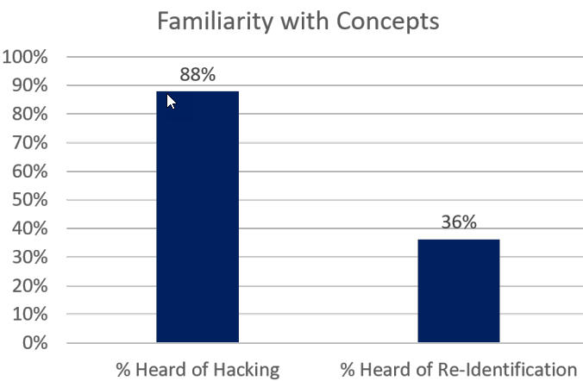
Privacy protections are harder to communicate
Measuring Privacy and Accuracy Concerns for 2020 Census Data Dissemination (Hunter-Childs, et al 2020)
Notes:
Finally, communicating privacy risks to inform principled benefit/harm calculations by data subjects is made more difficult by the fact that the general public is not well informed about the general risks of data sharing to support statistics. While 88% of the public may be familiar with the idea of data breaches from hacking, only 36% have heard of “re-identification” How can we effectively communicate our privacy protections if our audience doesn’t even understand the risk? Now, this problem isn’t unique to blended data, but is more salient insofar as re-id risks of blended data may be higher due to the availability of component files elsewhere.

Slide 20

What can we do about it?
Notes:
So, what can we do about it? How can we incorporate some communications best practices to address these privacy challenges?

Slide 21

Don’t attempt to explain everything to everyone
Notes:
First, avoid the temptation to just throw everything into your notice and consent statements. As the research on confidentiality assurances demonstrated, this may exacerbate rather than alleviate privacy concerns. When data are being collected, be mindful of the underlying “transaction” that is taking place, and how the data subject might best incorporate the added risks and the potential benefits of statistical re-use of those data into their privacy calculus.

Slide 22

Consider audience-specific messaging when appropriate
Notes:
Similarly, pay attention to the social and administrative contexts of the data subject at the point of collection, and to differences in privacy attitudes across demographic groups. To the extent possible, tailor privacy messages to the diverse concerns of these groups, or to the unique collection contexts.

Slide 23





Use multi-layered communications strategies
Customize privacy messaging and level of legal/technical detail by communications method and audience
Notes:
This one is a general comms strategy not unique to privacy or to blended data, but one that is especially valuable in this context is to use multi-layered communications strategies. Not everyone cares about privacy, and the strength of individuals’ privacy attitudes, and their technical sophistication vary substantially. Consequently, provide simple, short, and easy-to-understand assurances to your general audiences, with supplementary information of increasing detail and technical sophistication on demand for those who want to dig deeper.

Slide 24

Regularly engage with trusted partners
Invest in educating and engaging with trusted intermediaries and civil society groups
They can also alert you to audience-specific privacy concerns and changes in privacy attitudes over time
Notes:
Next, and this is one that I can say from personal experience, is incredibly valuable: Regularly engage with representatives of key stakeholder groups. If you invest in educating and engaging with trusted intermediaries and civil society groups, these groups can act as trusted voices to reassure their constituents about the anticipated benefits of participation and the privacy protections that are being used to safeguard their information.
Engaging with these groups can also alert you to audience-specific privacy concerns and changes in privacy attitudes over time.

Slide 25

Be transparent
“Increased transparency will enable the public to be informed about how data are being used to improve their government, even as data are being stringently protected.”
“Government also can dramatically improve transparency about its collection and use of data, improving the American public’s ability to hold the government accountable. Adhering to the highest possible standards with respect to privacy and accountability is an important part of earning the public’s trust.”
-Commission on Evidence-based Policymaking (2017)
Notes:
I should also note that one of the best privacy tools in our arsenal is transparency itself. As I’ve mentioned, privacy attitudes are contextual, transactional, and ever evolving. In the absence of full information, people often assume the worst…and those assumptions can and do color people’s attitudes about the privacy of their data. Bringing the full scope of our data practices and privacy protections into the sunshine can help ensure that data subjects contextual and transactional attitudes about sharing their data are based on truth, not fear or speculation.
…but this transparency, as critical as it is, can also come with some of its own communications challenges. We saw that, to a degree, on the first day of this workshop, with the AAJC analysis that Julia Lane discussed in her presentation. That report examined the potential implications of differential privacy on the 2020 Census redistricting data.
The Census Bureau has embraced transparency and stakeholder engagement throughout its initiative to develop an implement an effective differential privacy solution for protecting the 2020 census—as part of this effort, over the last four years we have released nine different sets of demonstration data to provide data users with opportunities to evaluate successive configurations of our disclosure avoidance system. The feedback we received led to system design and parameter changes that provided substantial improvements in accuracy for major use cases, including the redistricting use cases identified in the AAJC report.
The challenge here is that ongoing transparency, especially with regards to real time decision-making, research and development, or evolving work, is that information can soon become obsolete. In the case of the AAJC report, the data underlying the report were from an early set of demonstration data, released in November 2020. Subsequent sets of demonstration data, particularly the redistricting production settings demonstration data released in August 2021 superceded those data, and addressed many of the recommendations in the AAJC report.
When embracing transparency in their statistical activities and decisionmaking, agencies should be prepared for public confusion or misinformation that may arise from outdated information. Strong and reliable communications channels are critical here, to keep key stakeholders updated on important changes and developments, as is a robust and stable online repository of information (both current and historic) that stakeholders can turn to when they may be in doubt about the currency of the information they are considering.

Slide 26

Continue to research and track evolving public attitudes about privacy
Notes:
Finally, as privacy attitudes of the general public, and of specific groups, change and evolve, it’s critical to keep your finger on the pulse of those attitudes. Agencies should invest in strategies to track those evolving attitudes to inform future communications efforts.

Slide 27

Questions?
michael.b.hawes@census.gov
Notes:
So, in conclusion, communicating about privacy is not easy, and the increasing use of blended data will only complicate this challenge. But, there are effective communications strategies that can assist. Be strategic about what you say and how you say it, pay attention to context, engage with trusted intermediaries, and be transparent. And, as public attitudes about privacy evolve, don’t assume that strategies that work today will necessarily work tomorrow. Thank you.

